Slide 1
Fluidized Catalytic Cracker Design and Optimization
By: Hayden Migliore, Will Huck, and Zeke Marcel

Slide 2
Justification
Reaction and Kinetics
Sizing
Pricing
Optimization
Process Control and Safety

Slide 3
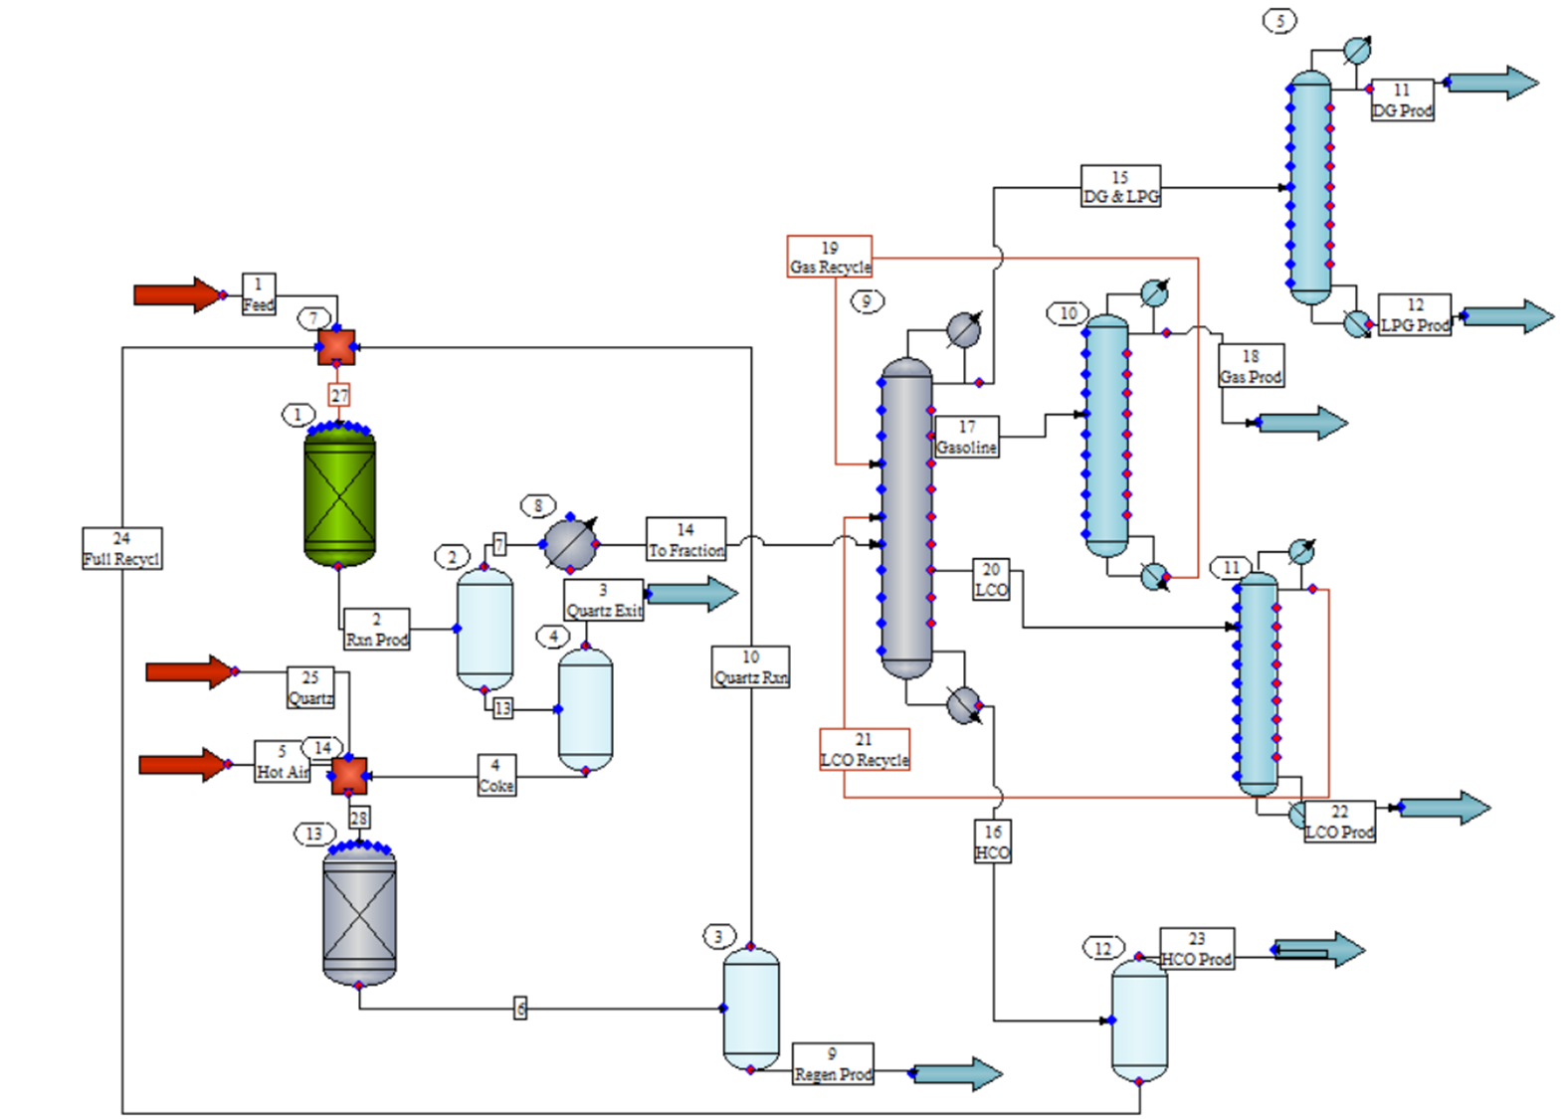
Justifications

Slide 4
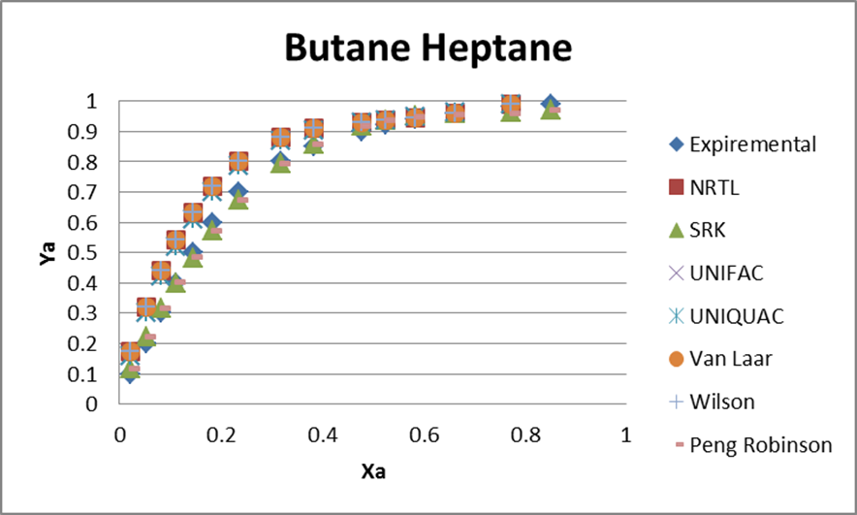
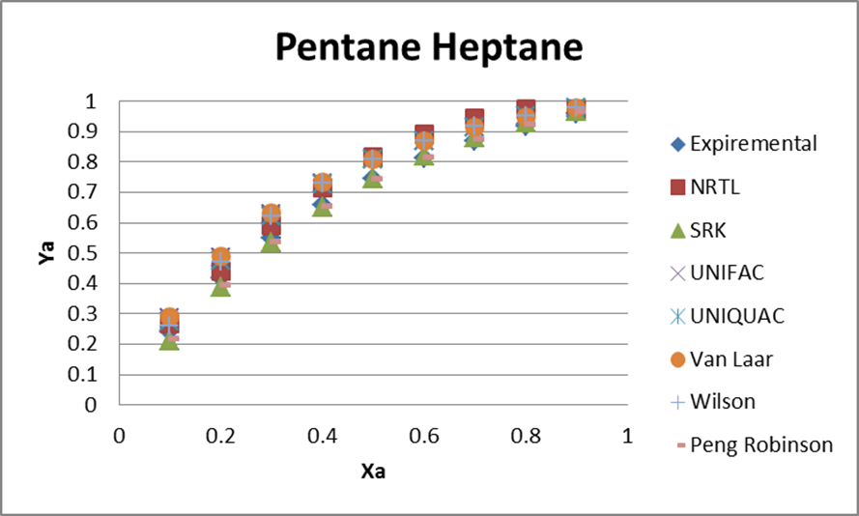
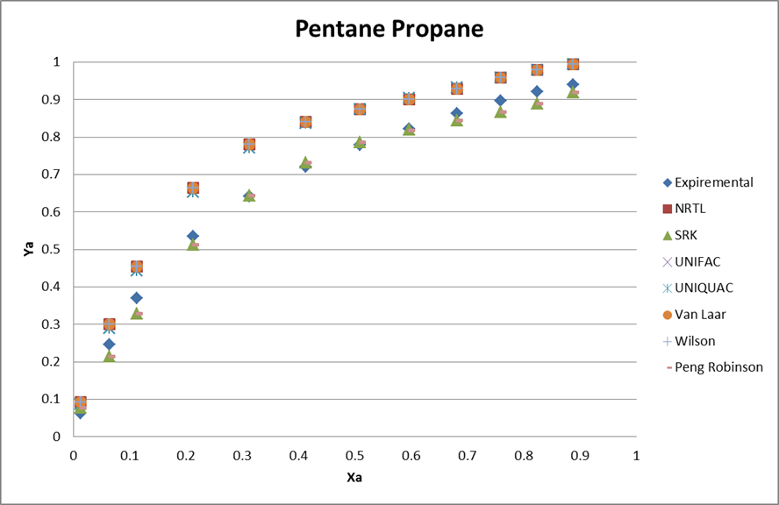
Thermodynamics Justification
Applicable VLE data for binary, ternary, and above systems valid to the system proved difficult to find
Structurally and chemically similar compounds were used to model the binary interactions. Propane (C₃H₈) and Heptane(C₇H₁₆).
Peing Robinson modeled the system the best.
Refrences
1. Seong, G., Lim, J. S., J. Chem. Eng. Data, 2008, 53 (12), pp 2783–2786
2. Cummings, L.W.T, Stones, F.W.,and Volante, M. A., Ind. Eng. Chem., 25, 728 (1933)
3. Kayukawa, Y., Fujii, K., Higashi, Y., J. Chem. Eng. Data, 2005, 50 (2), pp 579-582

Slide 5
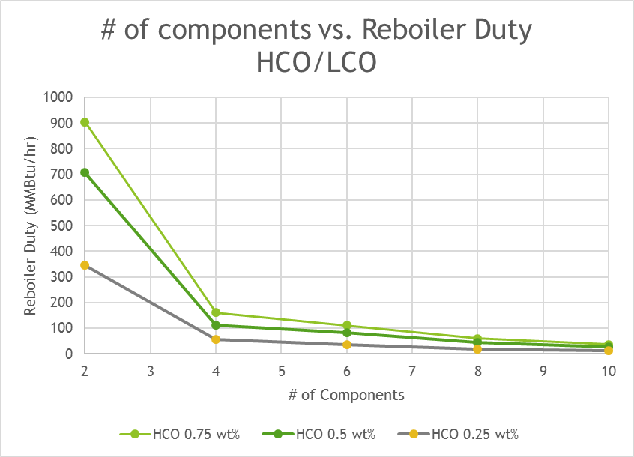
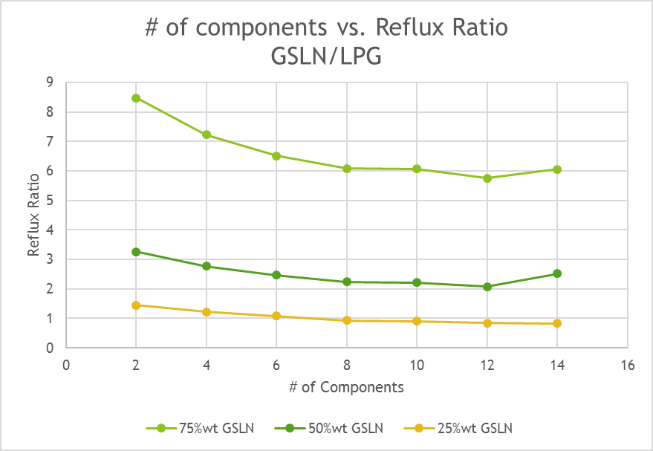
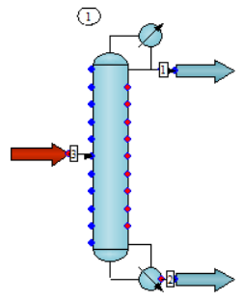
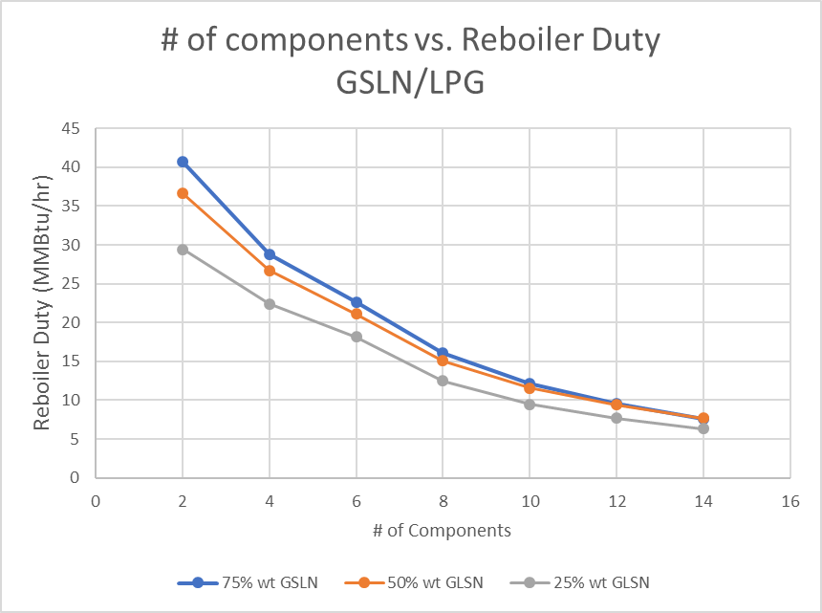
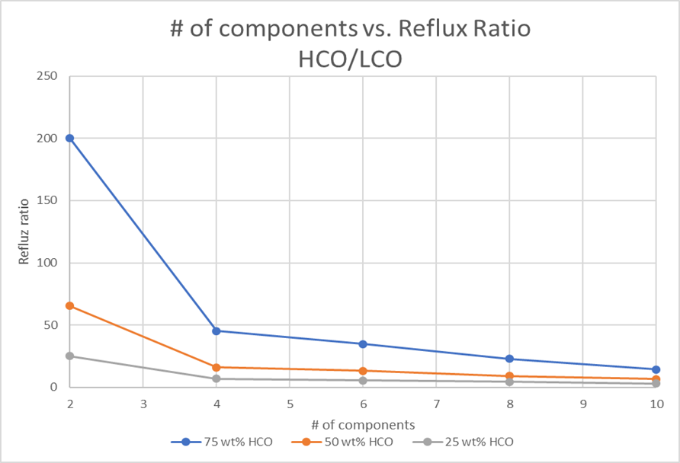
Number of Components Justification
Lump Equivalent | # of Components
Heavy Cycle Oil | 6
Light Cycle Oil | 6
Gasoline | 11
Light Petroleum Gas | 4
Dry Gas | 3

Slide 6
Feed Justification
 | Feed Stock
 | % (wt)
Parffins | 62.53
Aromatics | 15.45
Naphthalenes | 22.02
Feed Components where chosen based upon the largest available Pariffins, Aromatics, and Naphthalenes within the ChemCad data base
Component Name | CAS Number | Chemical Formula | Molecular Weight | Boiling Pt (F) | Lump Equivalent
Nonacosane | 630-03-5 | C29H60 | 408.8 | 825.5 | Heavy Cycle Oil
Hexacosane | 630-01-3 | C26H54 | 366.7 | 788 | Heavy Cycle Oil
N-Pentadecylbenzene | 2131-18-2 | C21H36 | 288.51 | 701.6 | Heavy Cycle Oil
N-Pentadecylcyclopentane | 6006-95-7 | C20H40 | 280.53 | 680.2 | Heavy Cycle Oil
Uneicosane | 629-94-7 | C21H44 | 296.58 | 673.7 | Heavy Cycle Oil
Eicosane | 112-95-8 | C20H42 | 282.5475 | 648.9 | Heavy Cycle Oil
Octadecane | 593-45-3 | C18H38 | 254.5 | 601 | Light Cycle Oil
N-Dodecylcyclopentane | 5634-30-0 | C17H34 | 238.45 | 593.4 | Light Cycle Oil
Cetane | 544-76-3 | C16H34 | 226.45 | 548.2 | Light Cycle Oil
Pentadecane | 629-62-9 | C15H32 | 212.421 | 519.1 | Light Cycle Oil
Pentadecene | 13360-61-7 | C15H30 | 210.41 | 515.3 | Light Cycle Oil
Phenylbenzene | 92-52-4 | C12H10 | 154.21 | 489 | Light Cycle Oil
The feed to the reactor consists of:
12.5% nonacosane
12.5% hexacosane
12.5% uneicosane
11% N-Pentadecylcyclbenzene
7.75% n-pentadecylbenzene
12.5% octadecane
11% N-dodecylcyclopentane
12.5% cetane
7.75% phenylbenzene
Sertić-Bionda, Katica, Zoran Gomzi, and Marko Mužic. "Modeling Of Gas Oil Catalytic Cracking In A Fixed Bed Reactor Using A Five-Lump Kinetic Model." Chemical Engineering Communications 197.3 (2010): 275-288. Academic Search Complete. Web. 12 Dec. 2016.

Slide 7
Product Justification
Component Name | CAS Number | Chemical Formula | Molecular Weight | Boiling Pt (F) | Lump Equivalent
Nonacosane | 630-03-5 | C29H60 | 408.8 | 825.5 | Heavy Cycle Oil
Hexacosane | 630-01-3 | C26H54 | 366.7 | 788 | Heavy Cycle Oil
N-Pentadecylbenzene | 2131-18-2 | C21H36 | 288.51 | 701.6 | Heavy Cycle Oil
N-Pentadecylcyclopentane | 6006-95-7 | C20H40 | 280.53 | 680.2 | Heavy Cycle Oil
Uneicosane | 629-94-7 | C21H44 | 296.58 | 673.7 | Heavy Cycle Oil
Eicosane | 112-95-8 | C20H42 | 282.5475 | 648.9 | Heavy Cycle Oil
Octadecane | 593-45-3 | C18H38 | 254.5 | 601 | Light Cycle Oil
N-Dodecylcyclopentane | 5634-30-0 | C17H34 | 238.45 | 593.4 | Light Cycle Oil
Cetane | 544-76-3 | C16H34 | 226.45 | 548.2 | Light Cycle Oil
Pentadecane | 629-62-9 | C15H32 | 212.421 | 519.1 | Light Cycle Oil
Pentadecene | 13360-61-7 | C15H30 | 210.41 | 515.3 | Light Cycle Oil
Phenylbenzene | 92-52-4 | C12H10 | 154.21 | 489 | Light Cycle Oil
N-Butylcyclohexane | 1678-93-9 | C10H20 | 140.27 | 356 | Gasoline
Decane | 124-18-5 | C10H22 | 142.29 | 345.4 | Gasoline
1-Decene | 872-05-9 | C10H20 | 140.27 | 339.1 | Gasoline
Octane | 111-65-9 | C8H18 | 114.23 | 257 | Gasoline
1-Octene | 111-66-0 | C8H16 | 112.24 | 249.8 | Gasoline
Cycloheptene | 291-64-5 | C7H14 | 96.17 | 238.5 | Gasoline
1-Heptene | 592-76-7 | C7H14 | 98.19 | 201.2 | Gasoline
Benzene | 71-43-2 | C6H6 | 78.11 | 176.2 | Gasoline
Cyclopentane | 287-92-3 | C5H10 | 70.1 | 120.2 | Gasoline
Pentane | 109-66-0 | C5H12 | 72.15 | 96.98 | Gasoline
1-Pentene | 109-67-1 | C5H10 | 70.135 | 86 | Gasoline
Butane | 106-97-8 | C4H10 | 58.12 | 30.2 | Light Petroleum Gas
1-Butene | 106-98-9 | C4H8 | 56.108 | 20.66 | Light Petroleum Gas
Propane | 74-98-6 | C3H8 | 44.1 | -43.6 | Light Petroleum Gas
1-Propene | 115-07-1 | C3H6 | 42.08 | -53.68 | Light Petroleum Gas
Ethane | 74-84-0 | C2H6 | 30.07 | -128.2 | Fuel Gas
Ethene | 74-85-1 | C2H4 | 28.05 | -154.7 | Fuel Gas
Methane | 74-82-8 | CH4 | 16.04 | -258.7 | Fuel Gas
Gasoline has a spread of paraffins, naphthalenes, olefins, and aromatic rings. It also has a strong range from C10 to C5.
Light Petroleum Gas includes all reasonable components.
Dry Gas includes all reasonable components.
Sertić-Bionda, Katica, Zoran Gomzi, and Marko Mužic. "Modeling Of Gas Oil Catalytic Cracking In A Fixed Bed Reactor Using A Five-Lump Kinetic Model." Chemical Engineering Communications 197.3 (2010): 275-288. Academic Search Complete. Web. 12 Dec. 2016.

Slide 8

Reaction and Kinetics

Slide 9
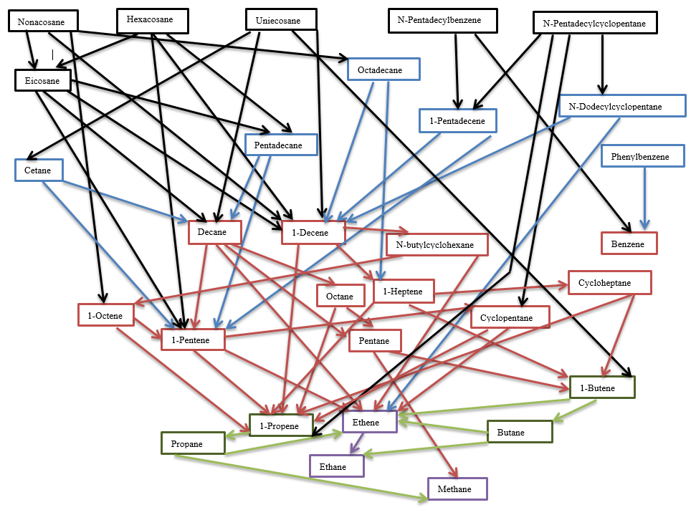
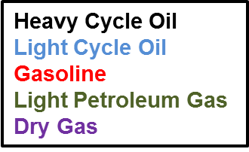
Our Reaction Pathways will cause all components to degrade to coke

Slide 10
Our kinetics value force our components to match weight fractions based on literature values
Reaction | Reaction Number | Frequency Factor | Activation Energy
Nonacosane -> Eicosane + Octene + Coke | 1 | 1425 | 13650
Nonacosane -> Octadecane + Decene + Coke | 2 | 1425 | 13650
Hexacosane -> Eicosane + Pentene + Coke | 3 | 1400 | 13650
Hexacosane -> Pentadecane + Decene + Coke | 4 | 1425 | 13650
Uneicosane -> Decane + Decene + Coke | 5 | 1425 | 13650
Uneicosane -> Cetane + Butene+ Coke | 6 | 1425 | 13650
Eicosane -> Pentadecane + Pentene | 7 | 1425 | 13650
Eicosane -> Decane + Decene | 8 | 1425 | 13600
N-Pentadecylbenzene -> Benzene + Pentadecene | 9 | 2000 | 13650
N-Pentadecylcylopentane -> Cyclopentane + Pentadecene | 10 | 1500 | 13650
N-Pentadocylcyclopentane -> N-Dodecylcyclopentane + Propene | 11 | 1500 | 13650
Octadecane -> Decane + Heptene + Coke | 12 | 1450 | 9000
N-Dodecylcyclopentane -> Decene + Ethene + Cyclopentane | 13 | 1450 | 9000
Cetane -> Decane + Pentene + Coke | 14 | 1450 | 9000
Pentacdecane -> Decane + Pentene | 15 | 1450 | 9000
Pentadecene -> Decene + Pentene | 16 | 1450 | 9000
Phenylbenzene + Hydrogen -> 2 x Benzene | 17 | 2000 | 9000
Decane -> Octane + Ethene | 18 | 700 | 10000
Decane -> Petane + Pentene | 19 | 1000 | 9000
Decene -> N-butylcyclohexane | 20 | 900 | 12000
Decene -> Heptene + Propene | 21 | 1000 | 8900
N-butylcyclohexane -> Octene + Ethene | 22 | 930 | 10000
Octane -> Pentane + Propene | 23 | 1600 | 7900
Octene -> Petene + Propene | 24 | 1600 | 7000
Heptene -> Cycloheptane | 25 | 1600 | 8100
Heptene -> Butene + Propene | 26 | 2020 | 7950
Cycloheptane -> Butene + Propene | 27 | 1100 | 6000
Pentane -> Butene + Methane | 28 | 1000 | 6000
Pentene -> Cyclopentane | 29 | 1000 | 6000
Pentene -> Propene + Ethene | 30 | 1560 | 8000
Pentene + Hydrogen -> Pentane | 31 | 900 | 9000
Cyclopentane -> Ethene + Propene | 32 | 50 | 9000
Butane -> Ethane + Ethene | 33 | 10 | 10000
Butene -> 2 x Ethene | 34 | 100 | 10000
Butene + Hydrogen -> Butane | 35 | 20000 | 10000
Propane -> Ethene + Methane | 36 | 100 | 10000
Propene + Hydrogen -> Propane | 37 | 20000 | 10000
Ethene + Hydrogen -> Ethane | 38 | 20000 | 10000
Ethene -> Coke | 39 | 1000 | 5000
Methane -> Coke | 40 | 1000 | 5000
Benzene -> Ethene + Coke | 41 | 1200 | 5000
We used a random number generator to find decent frequency factor and activation energy values and compared them to a sum of square error.
After a certain point, we took over and adjusted the values ourselves to get the weight fraction curves correctly.
Chang-Bock Chung, In-Su Han, Dynamic modeling and simulation of a Fluidized catalytic cracking process. Part II: Property estimation and simulation, Chemical Engineering Science 56 (2001) 1973-1990

Slide 11
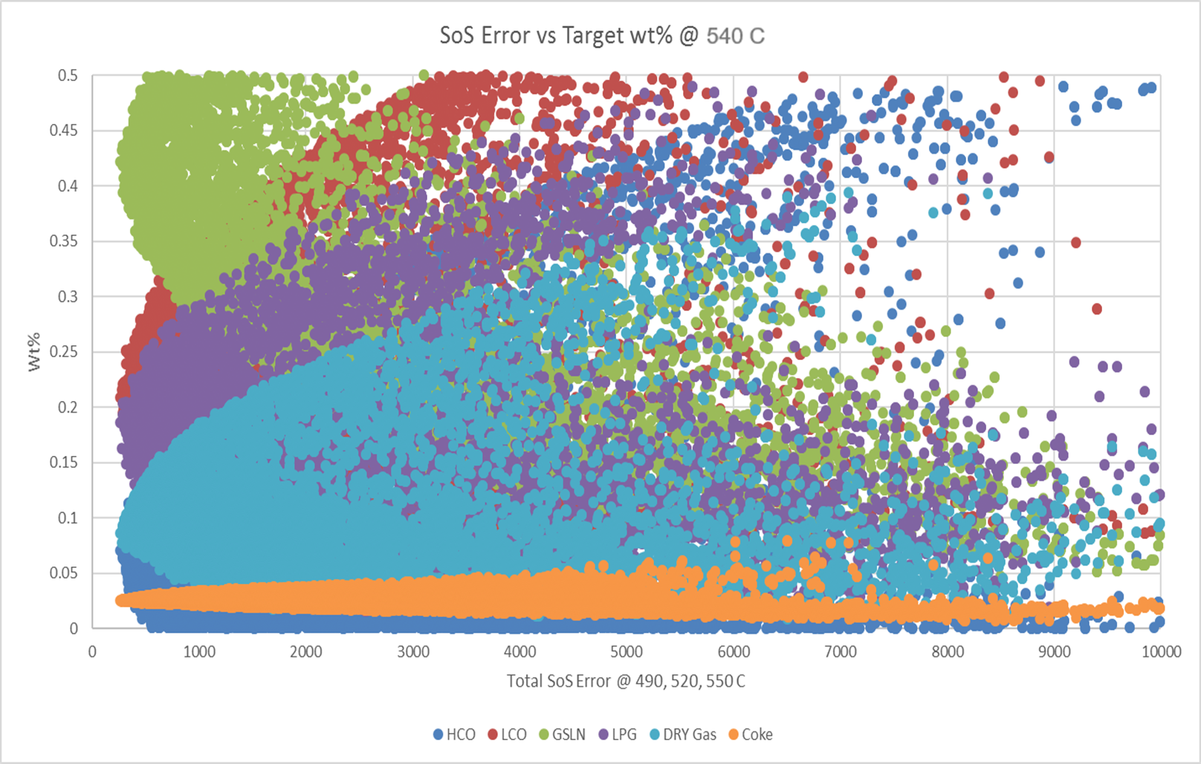
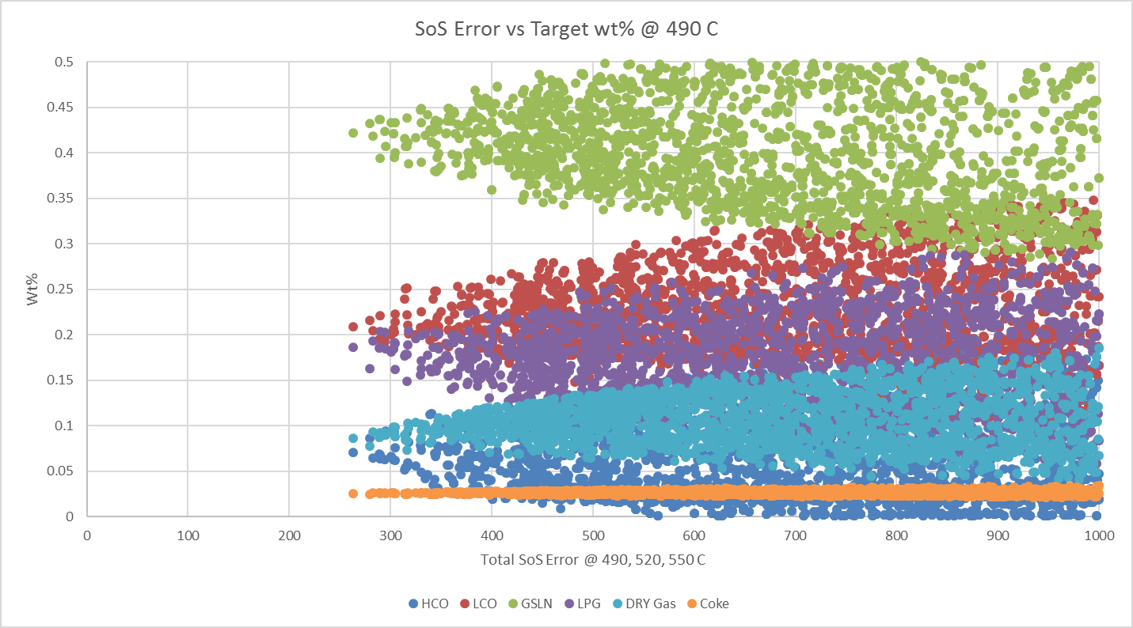
Random Number Generator
Temp (C ) | deg C | 510 | 520 | 530 | 540
GSLN | % (wt) | 45.03 | 45.37 | 44.79 | 42.89
LPG | % (wt) | 17.43 | 20.06 | 20.9 | 21.86
Dry Gas | % (wt) | 3.24 | 3.9 | 4.44 | 5.67
LCO | % (wt) | 21.38 | 19.01 | 18 | 18.03
HCO | % (wt) | 9.34 | 8.06 | 8.01 | 7.24
Coke | % (wt) | 3.54 | 3.8 | 3.98 | 4.35

Slide 12
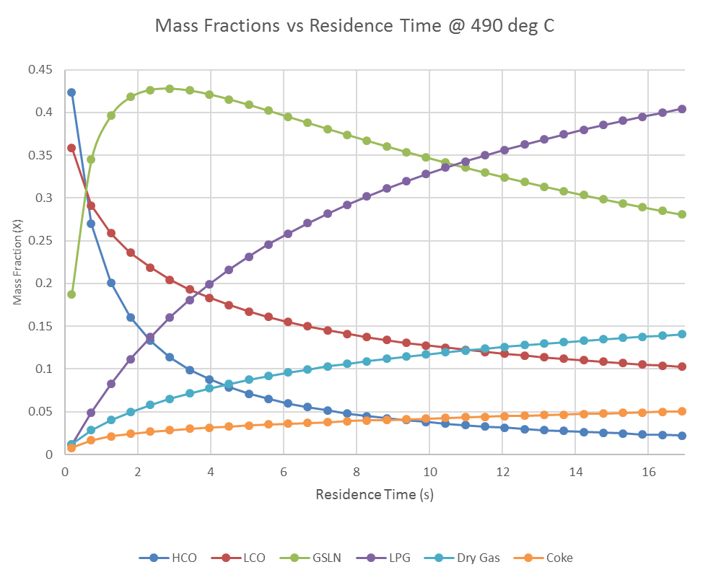
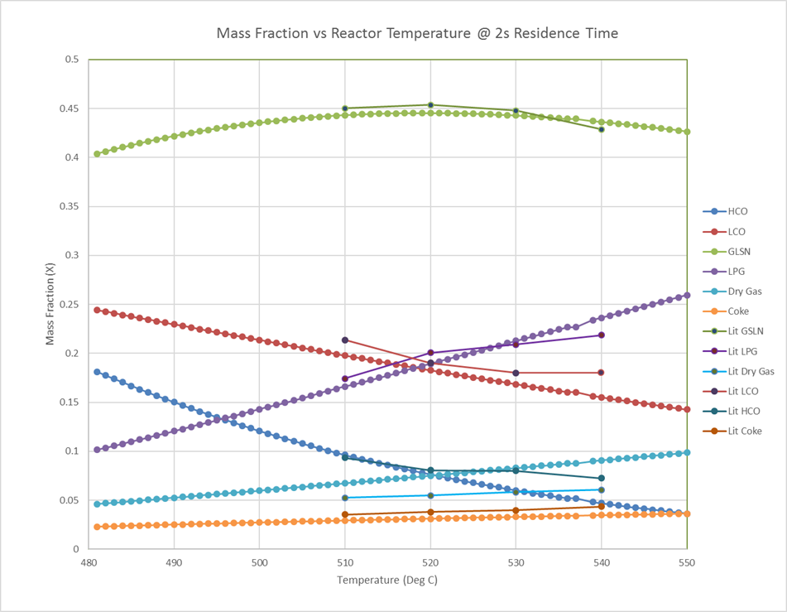
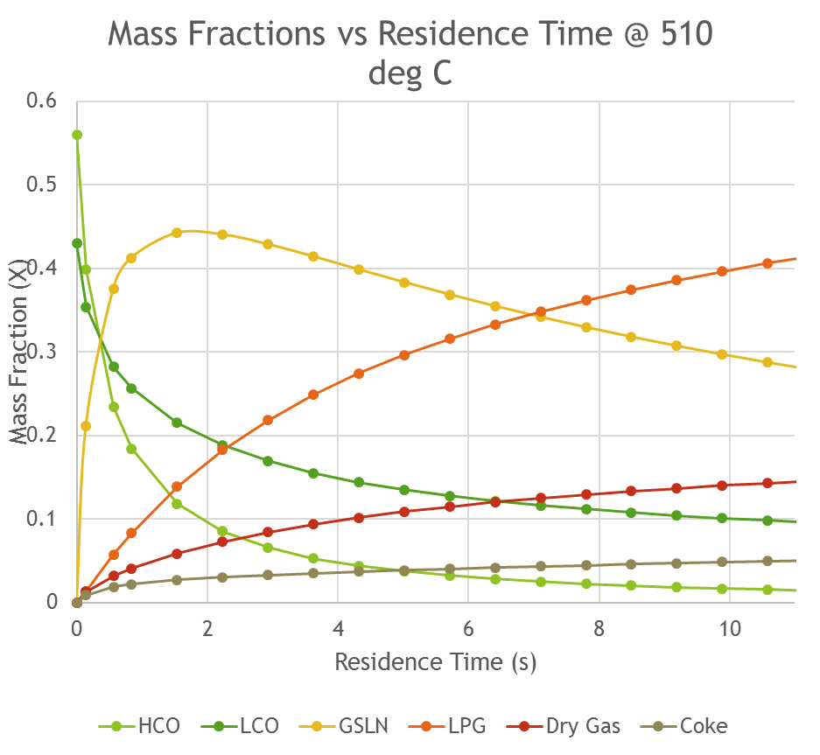
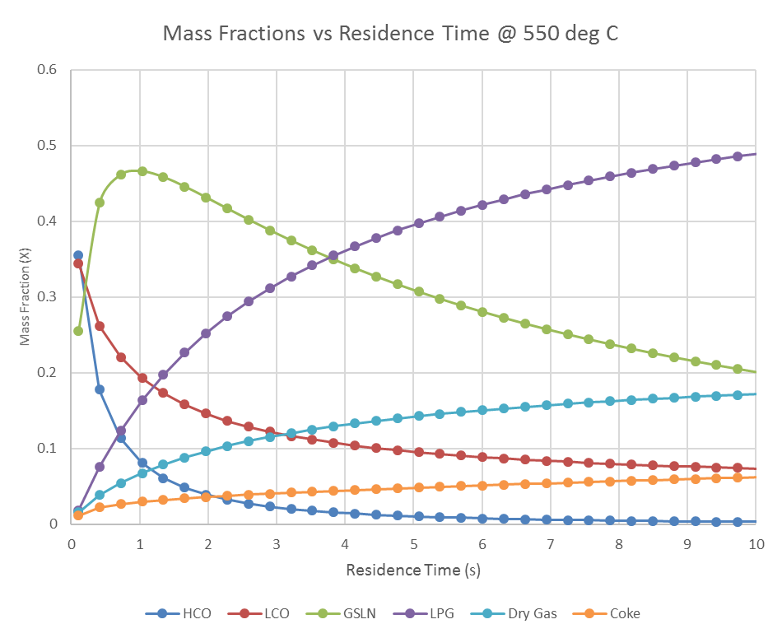
Literature Values and Kinetics
Our components’ mass fraction change with temperature at a reasonable rate
Chang-Bock Chung, In-Su Han, Dynamic modeling and simulation of a Fluidized catalytic cracking process. Part I: Process modeling, Chemical Engineering Science 56 (2001) 1951-1971
Chang-Bock Chung, In-Su Han, Dynamic modeling and simulation of a Fluidized catalytic cracking process. Part II: Property estimation and simulation, Chemical Engineering Science 56 (2001) 1973-1990

Slide 13
Sizing

Slide 14
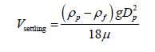
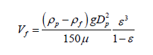
Frac. Feed
Flue Gas
Regenerator Sizing
Reactor Sizing
Disengaging Vessel
Disengaging Vessel
Disengaging Vessel
Settling=.676 ft/s
D=53.8 ft
H=21 ft
Settling=2.64 ft/s
D=53.8 ft
H=61.45 ft
Spent Cat.
Riser
3 min hold up time
Volume = Q* Residence Time
Fluidization Velocity = 2V_{f}
Void Fraction ε= 0.45
Riser
Volume = Q* Residence Time
Fluidization Velocity = 30V_{f}
Cat.
Riser
Air
30V_{f}= 26.77 ft/s
D=9.78 ft
H= 130.5 ft
2V_{f}=1.35 ft/s
D=38.1 ft
H=12.4 ft
Feed

Slide 15
Pricing

Slide 16
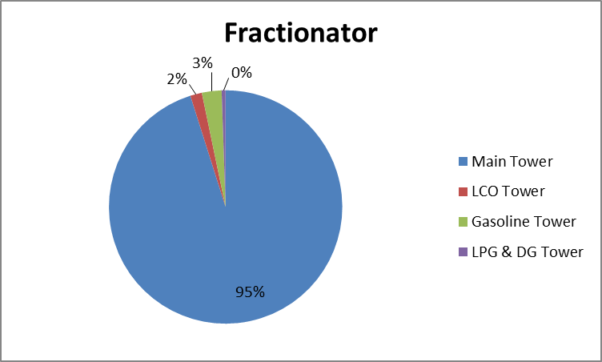
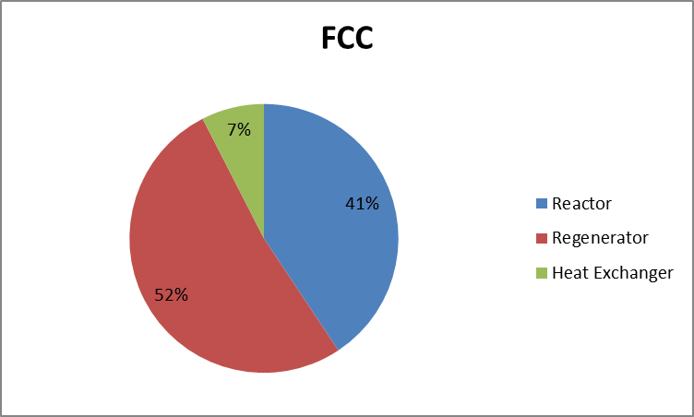
Component Costs

Slide 17

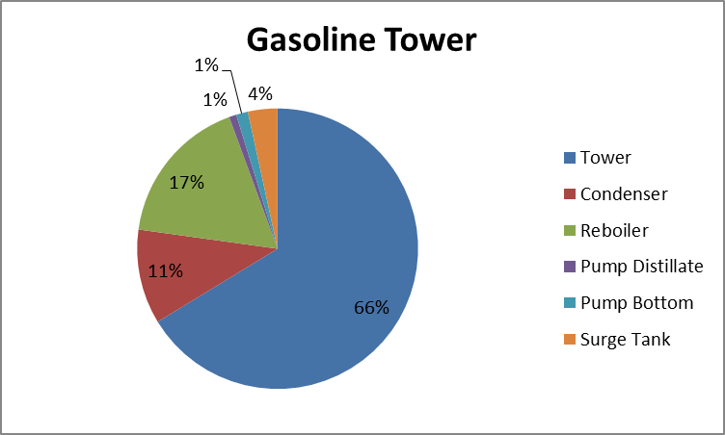
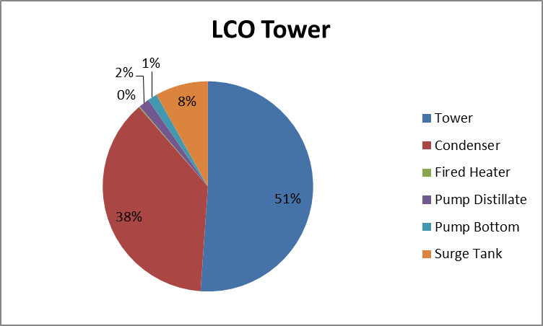
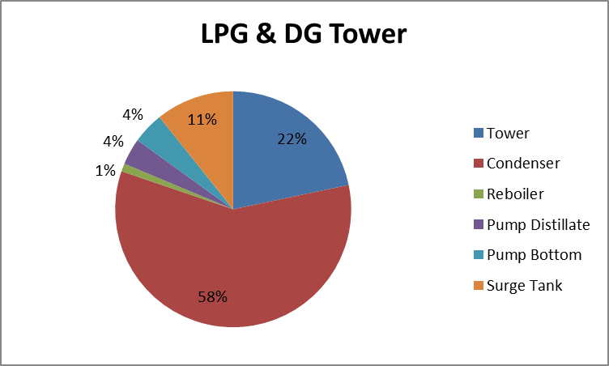
Tower Component Costs

Slide 18
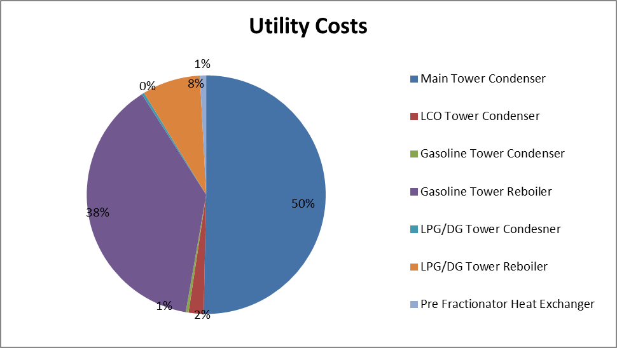
Utility Costs
The fired heaters will be powered by the hydrogen removed from the dry gas stream. That amount of hydrogen should be able to produce 143 MMBtu, and the fired heaters require 81 MMBtu.

Slide 19
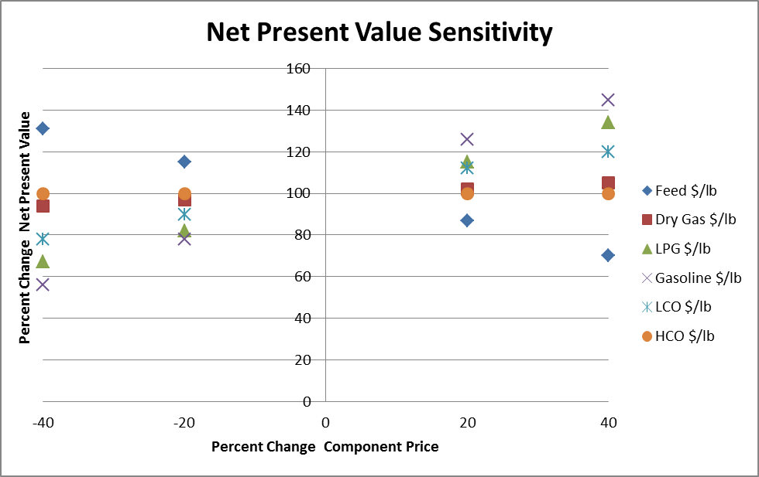
Pricing Sensitivity

Slide 20
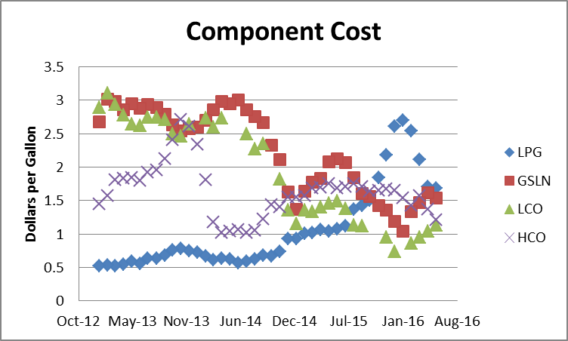
Pricing Research

Slide 21
Optimization

Slide 22
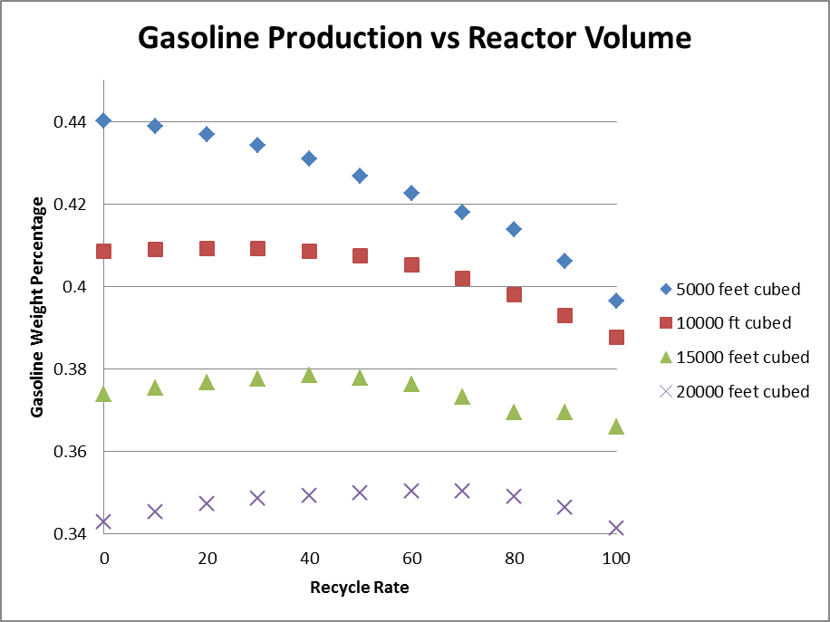
Our reactor volume and recycle rate is optimized through gasoline, LPG, and LCO production
Best Case:
5000 ft³ reactor riser volume with a 100% recycle rate
This gives us good gasoline production while allowing us to be flexible with the LCO and LPG production

Slide 23
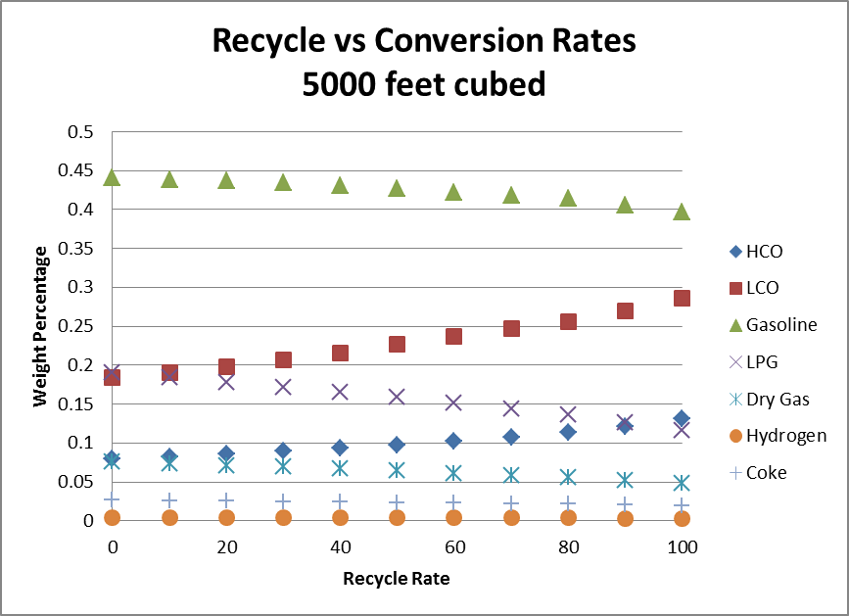
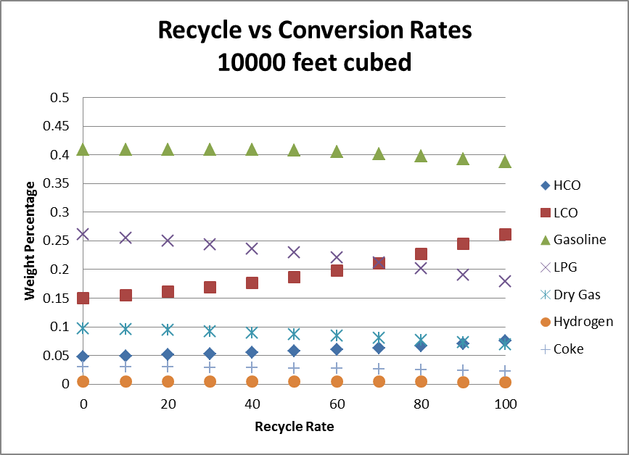
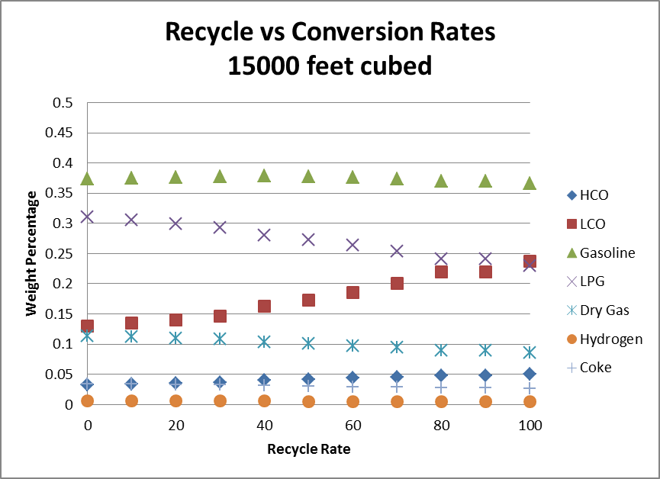
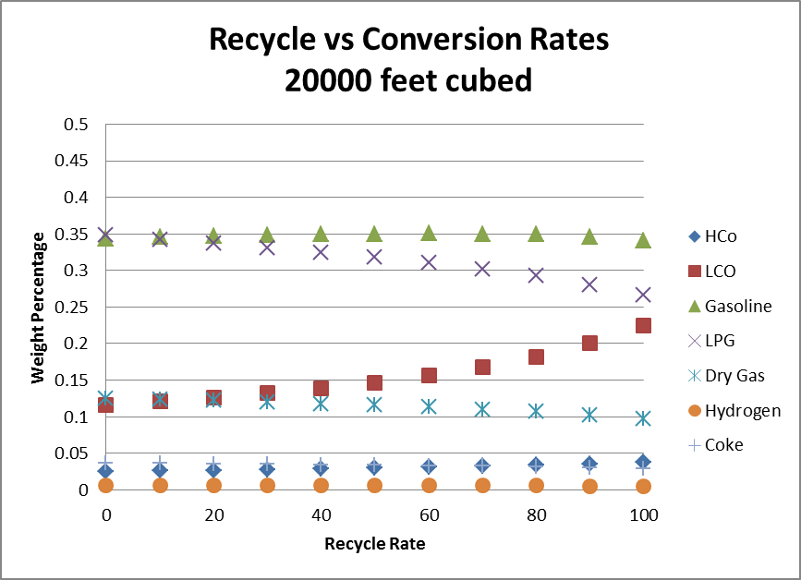
Our reactor volume and recycle rate is optimized through gasoline, LPG, and LCO production

Slide 24
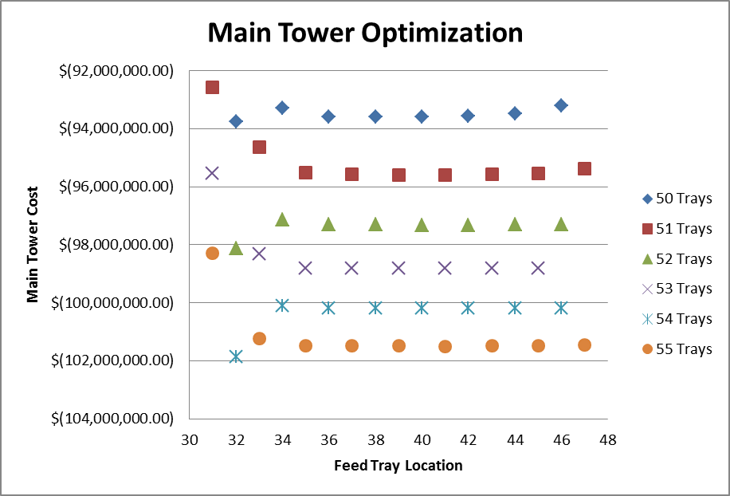
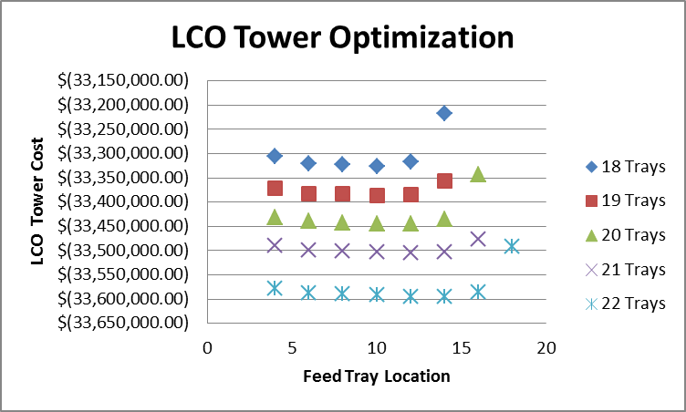
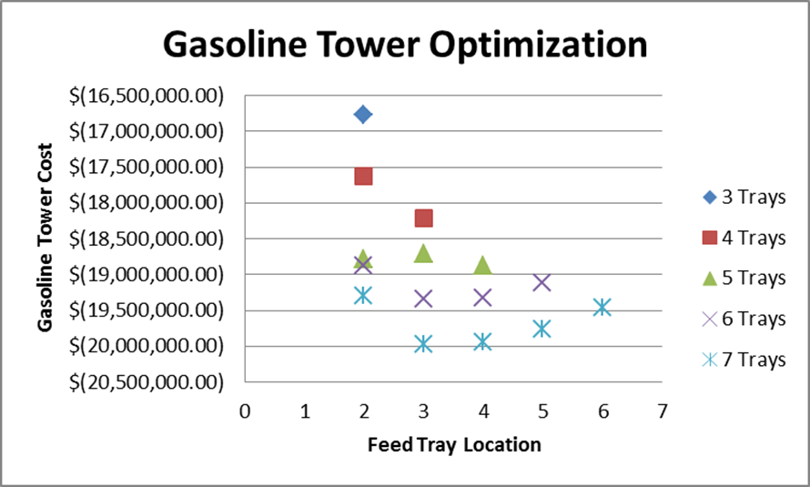
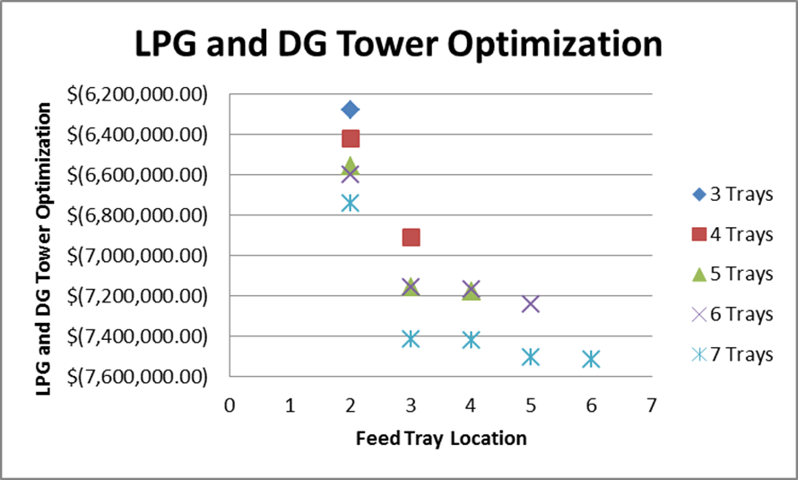
Our towers are optimized by minimizing cost while maintaining purity

Slide 25
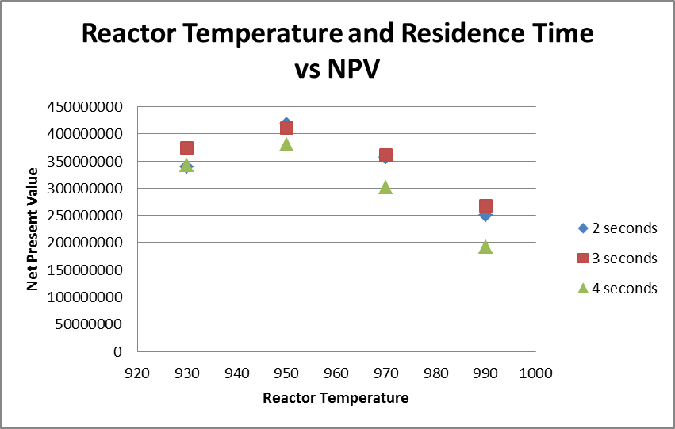
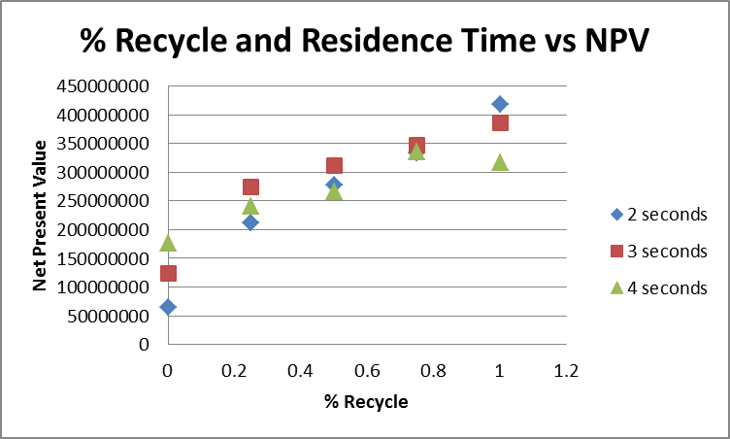
Best Case Optimization is based on reactor temperature, residence time, and recycle rate with optimizations
Best Case Net Present Value: $417,000,000

Slide 26
Process Control and Safety

Slide 27
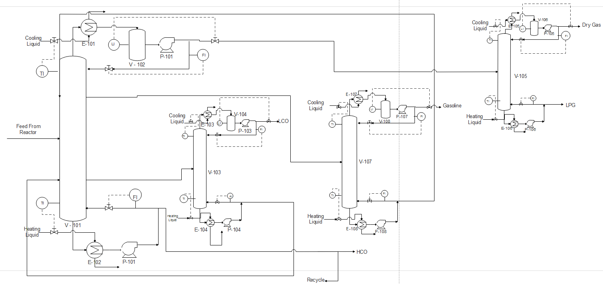
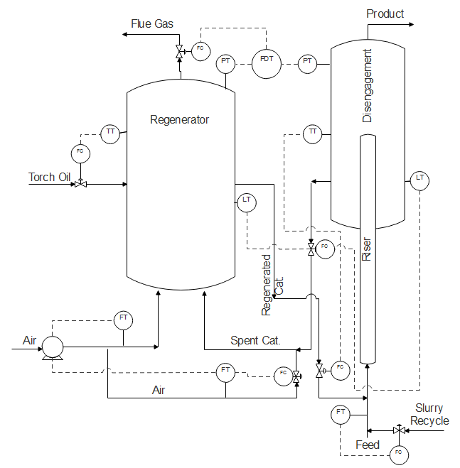
FCC and Fractionator Control
Pressure Differential between the Reactor and the Regenerator is controlled by regulating the exiting flue gas
Reactor temperature controlled by Cat./Oil Ratio
Catalyst hoppers are used to regulate the regenerated catalyst to feed and spent catalyst to the regenerator
Energy Balance: Regenerator produces 236.9 MMBtu per hour while the reactor requires 220.2 MMBtu per hour

Slide 28
FCC Process Flow Diagram

Slide 29
FCC Safety Concerns
Reactor temperature is maintained by the of recycled catalyst
Temperature of the regenerator is controlled by the air flow rate
A shutoff valve is attached to a differential pressure gauge and will trigger if the pressure difference between the reactor and regenerator becomes too low
Level of catalyst inside the reactor controlled by the flow of catalyst out of the cyclone
The pressure inside the regenerator is controlled by the flue gas flow rate
The flow rate of the catalyst and recycle from the fractionator are controlled by the flow rate of the stream entering the reactor

Slide 30
Fractionator Process Flow Diagram

Slide 31
Fractionator Safety Considerations
Temperature indicators are place on the bottom and top of each tower and used to control the flow rate of the heating or cooling fluid into the heat exchangers
Level indicators are placed on each surge tank and are used to control the flow rate of the distillate stream to maintain hold up time
Flow indicators are used to control the reflux and boil up ratios on each tower

Slide 32
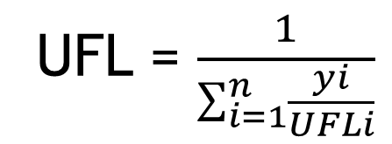
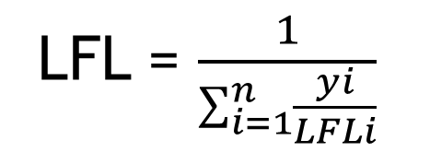
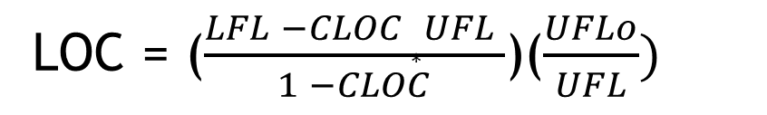
FCC Fire Safety Considerations
UFL = $\frac{1}{\sum_{i=1}^{n}{\frac{yi}{UFLi}}}$
Components | mole fracation | LFL | UFL
Decane | 0.026 | 0.8 | 5.4
N-Butylcyclohexane | 0.029 | 1.8 | 8.6
Octane | 0.012 | 0.8 | 6.5
Cycloheptane | 0.013 | 1.3 | 8
Benzene | 0.018 | 1.4 | 7.1
Pentane | 0.052 | 1.4 | 7.8
1-Pentene | 0.008 | 1.5 | 8.7
Cyclopentane | 0.072 | 2.4 | 10.4
Butane | 0.0006 | 1.8 | 8.5
1-Butene | 0.06 | 1.6 | 9.3
Propane | 0.005 | 2.1 | 9.5
Propene | 0.24 | 2 | 11
Ethane | 0.0002 | 3 | 12.5
Ethene | 0.19 | 2.7 | 36
Methane | 0.0009 | 5 | 15
Hydrogen | 0.1483 | 4 | 75
total | 0.875 | 2.3 | 15.4
LFL = $\frac{1}{\sum_{i=1}^{n}{\frac{yi}{LFLi}}}$
LOC = ($\frac{LFL −CLOC ∗UFL }{1 −CLOC}$)($\frac{UFLo}{UFL})$
LOC = 10.6 mole % oxygen
MIE = 0.2 mJ
LFL – Lower Flammability Limit
UFL – Upper Flammability Limit
LOC – Limiting Oxygen Concentration
MIE – Minimum Ignition Energy

Slide 33
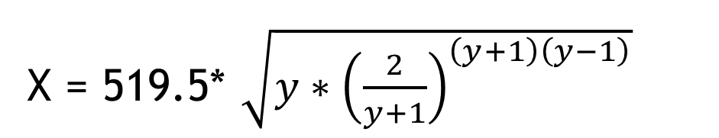
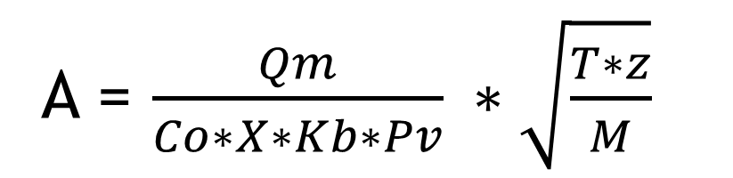
Reactor and Regenerator Relief Valve Sizing
A = $\frac{Qm}{Co∗X∗Kb∗Pv} ∗\sqrt{\frac{T∗z}{M}}$
X = 519.5* ${\sqrt{y∗{\left(\frac{2}{y+1}\right)}^{\left(y+1\right)\left(y−1\right)}}}^{}$
Reactor A = 37.3 in^2
Qm = 52228 GPM D = 6.9 in
Co = 0.975
Kb = 1
Pv = 17.8 psi
X = 336.9
T = 1409 R
M = 68.26
y = 1.2
Regenerator A = 10.4 in^2
Qm = 12176 GPM D = 3.6 in
Co = 0.975
Kb = 1
Pv = 23.4 psi
X = 355.7
T = 1509 R
M = 31.41
y = 1.4

